Slide 1

Video Game
Nguyen Quang Huy
- Fujitsu VN -

Slide 2
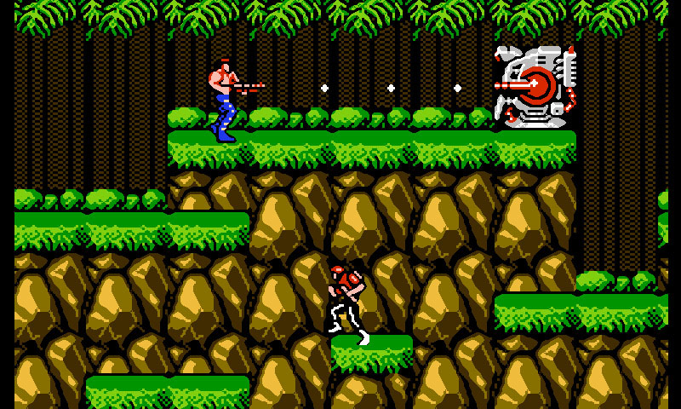
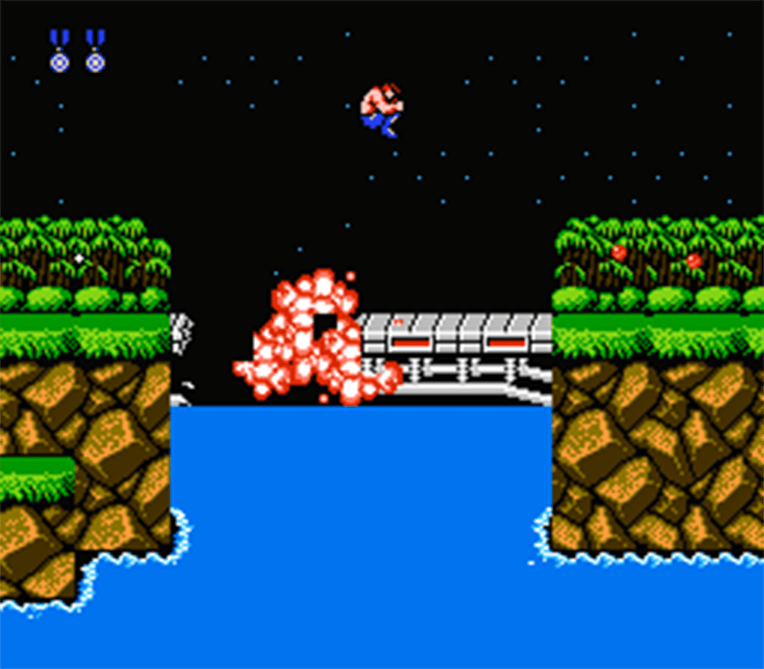
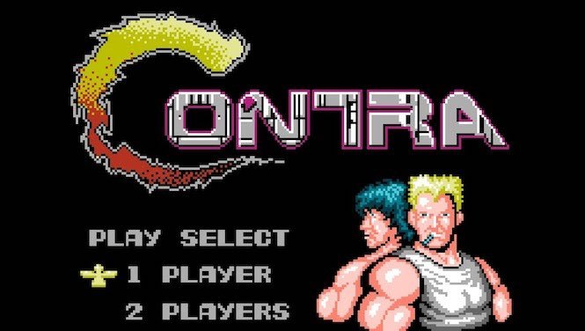
Notes:
Video game, that is electronic game that we interact via some devices like handheld, mouse, keyboard

Slide 3

Features
Graphics
Sound effect, background music
Level design, reward
Gameplay
Story

Slide 4



Game Types
Role-playing game (RPG)
First Person Shooter (FPS)
Sport
Puzzle
Education
Racing

Slide 5
Advantages & Disadvantage
Advantages
Disadvantages
Relaxing
Improve creativity and imagination
Make decision faster
More clever
Innovative education
Building relationship
Spend too much time/money
Leave the real life
Age-unfit

Slide 6

Conclusion
Play for fun
Play suitable game
Maintain balance

